Slide 1
Introduction to Power BI
Devin Knight
dknight@pragmaticworks.com
@knight_devin

Slide 2





About Devin
Popup books about maintaining a healthy relationship with your miniature donkeys.
And supporting cult being investigated by the government.
Blogs mainly consist of a collection of internet cat pictures
Will Work for cupcakes
Training Director
SQL Server MVP
Author of 5 books
Runs JSSUG User Group
Blogs at BIDN.com
Twitter: @knight_devin
DKnight@pragmaticworks.com
Notes:
Dustin Starts

Slide 3

Agenda
    What is Power BI
    Tour of each of the Power BI tools
    Power BI Pricing

Slide 4
Power Map BI Overview
Power Query
Allows you to extract and transform data from extraneous data sources
Power Pivot
Creates data models using mash ups
extraneous data sources
Power View
Data visualization tool that enables you to quickly gain business insight into your data
Power Map
3-D Mapping Data Visualization Tool
Power BI Sites
Share, view and interact with reports in a collaborative site
Power BI Q&A
Provides that ability to interrogate your data using natural language queries
Power BI App (Mobile BI)
Mobile app that allows you to view reports while on the go

Slide 5
Self-Service BI Lifecycle
Data Extraction
Data Modeling
Data Presentation

Slide 6





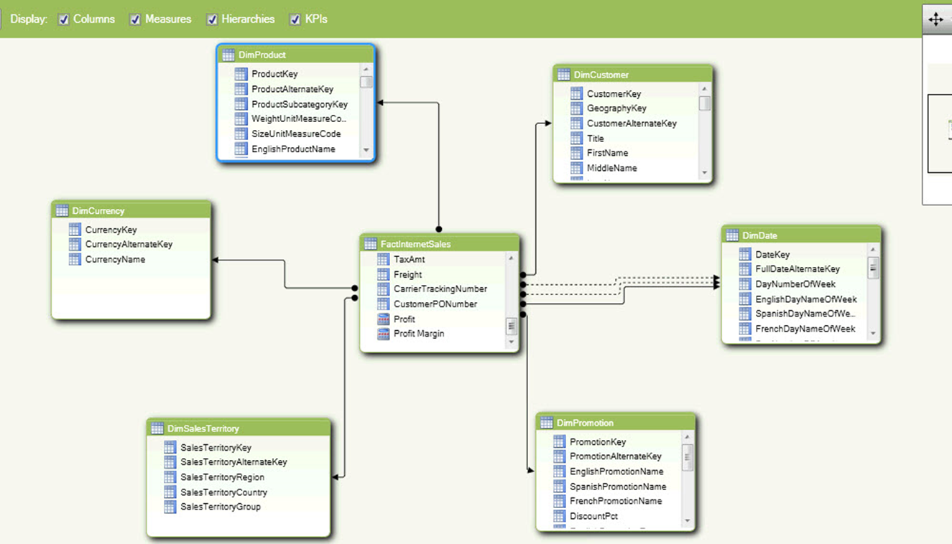



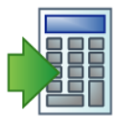









Data Extraction
Data Modeling
Data Presentation
Databases
Power Pivot
Excel
Power Pivot
Tables
Flat Files
Power Query
Power View
Charts
Reporting Services
Power Map
Relationships
Apps For Office
Cloud
Hierarchies
Power View
Calculations
Tables
Power Map
Template
Template
Template
Template
Power Query
Key Performance Indicators
Charts
SharePoint Lists
Internet
Maps
Active Directory
Exporting
Facebook
Hadoop
Power Map
3-D Maps
Template
Notes:
Why do we need two tools to Data Extraction?

Slide 7
Power Query
Discover
Refine
Combine

Slide 8
Demos
Discover -> Consume -> Visualize
Data Wrangling
Putting it all together

Slide 9


Power Pivot
Performance
  Uses In-Memory Technologies Providing Unmatched Analytical Performance
Short Development Cycles
Quick and Easy to Create and End to End Solution
End User Capable
Familiar Tools with Enhanced Capabilities
Millions Excel Users Worldwide

Slide 10
Demos
Creating a Data Model
Adding Relationships
Designing Hierarchies

Slide 11
Power View
Reporting Services
Report Builder
Use by Developers
Intended for Power Users
Highly Customizable
Development in Visual Studio
Power View
Click-Once Application
Designed for End Users
Office Look and Feel
Data Exploration Tool
Silverlight Based

Slide 12
Demos
Creating Charts in Power View

Slide 13
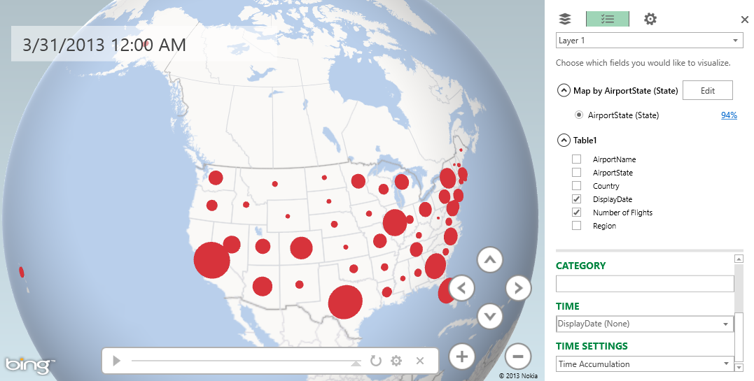
Power Map Overview
Power Map Features
3-D Data Visualization Tool for Excel 2013
Plots Geography Data Visually
Analyze Data on a 3-D globe Using Bing
Create Visual Tours to Share with Others

Slide 14
Demos
Linking Geographical Data to Power Map
Mapping Data Across Time
Creating a Power Map Tour

Slide 15
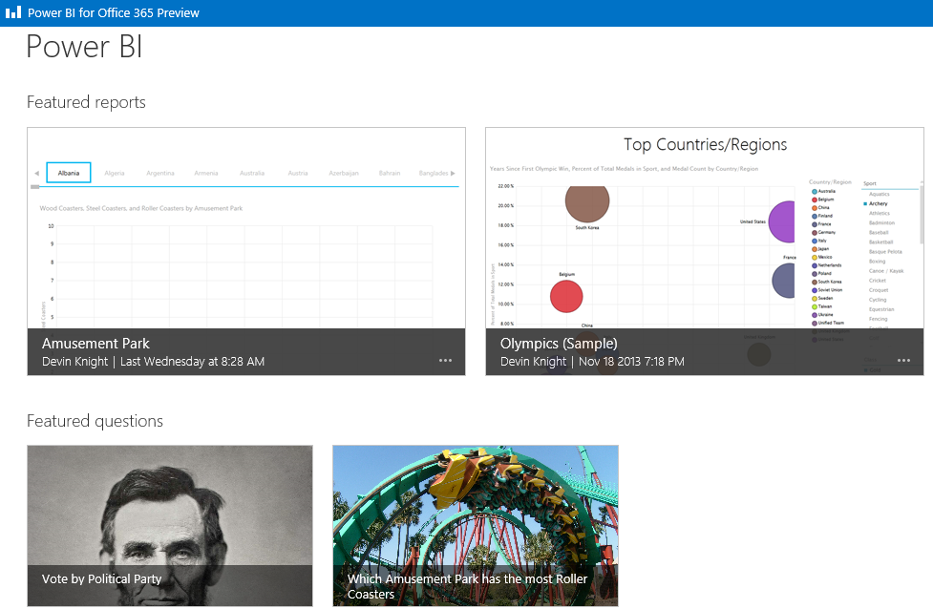
Power BI Sites
Collaboration
Deploy Excel workbooks to share with others
Power BI Q&A built in to Power BI site

Slide 16

Power BI Q&A
User Experience
Uses Natural Query Language to return results
Making it Work
Works on Power Pivot models deployed to a Power BI site
Use Synonyms in Power Pivot to tune Natural Queries

Slide 17
Demos
Deploying Reports to the Power BI site
Using Power BI Q&A on your Model

Slide 18
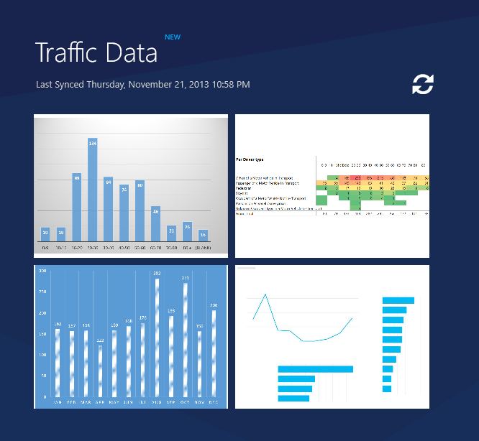
Power BI App (Mobile BI)
Mobile BI
Gives you Power BI on the go
Connects to your Power BI site

Slide 19
Demos
Quick view of Power BI App

Slide 20
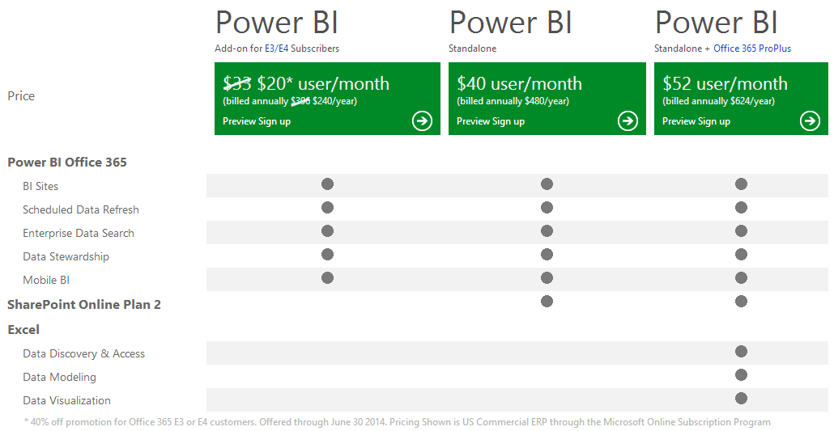
Power BI Pricing

Slide 21
Thanks!
Email: dknight@pragmaticworks.com
Twitter: @knight_devin
Blog: www.devinknightsql.com

