Slide 1
Data Mining
It's not the size of your data it's what you do with it
Presentation by
Adam Jorgensen (@ajbigdata)
adam@pragmaticworks.com
Devin Knight (@knight_devin)
dknight@pragmaticworks.com
Notes:
This all-demo session will focus on data mining from non-traditional sources. Many of you can mine from a nice clean dataset, but we will use the new Tabular model to consolidate data from disparate sources and perform some basic cleansing and mining that an end user can do once they know how! This session will be total audience participation - not a slide lecture and not one silly demo!

Slide 2
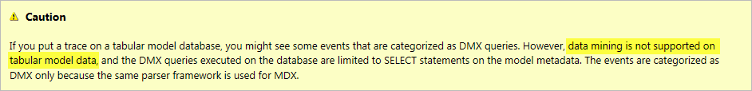
Data Mining with Tabular?

Slide 3
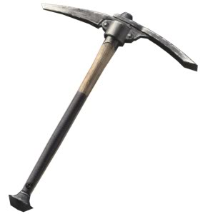
Agenda
What is Data Mining and how do you use it?
SQL Server Data Mining
Data Mining with Office 2012

Slide 4


Real Life examples

Slide 5

What does Data Mining Do
Explores Your Data
Finds Patterns
Performs Predictions

Slide 6
Value of Data Mining
Business Knowledge
Excel
SQL Server
Data Mining
Relative business value
OLAP
Reports (Adhoc)
Reports (static)
Simple Complicated
Usability

Slide 7
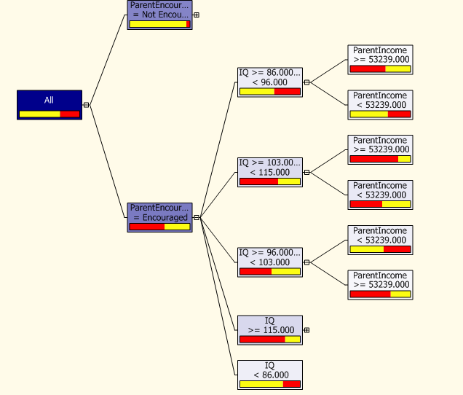
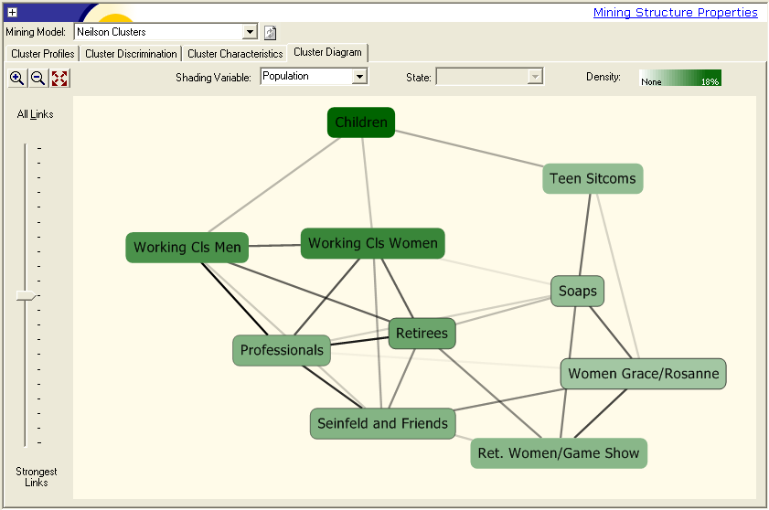
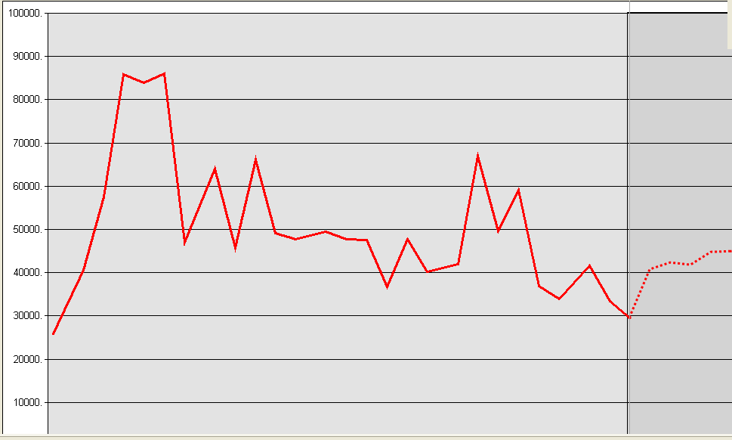
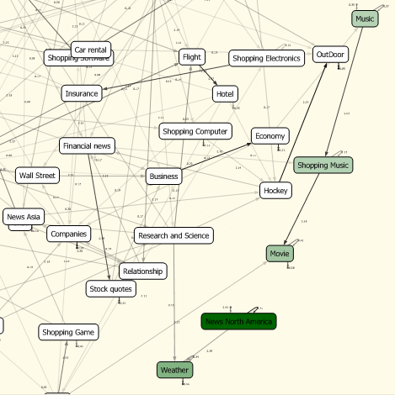
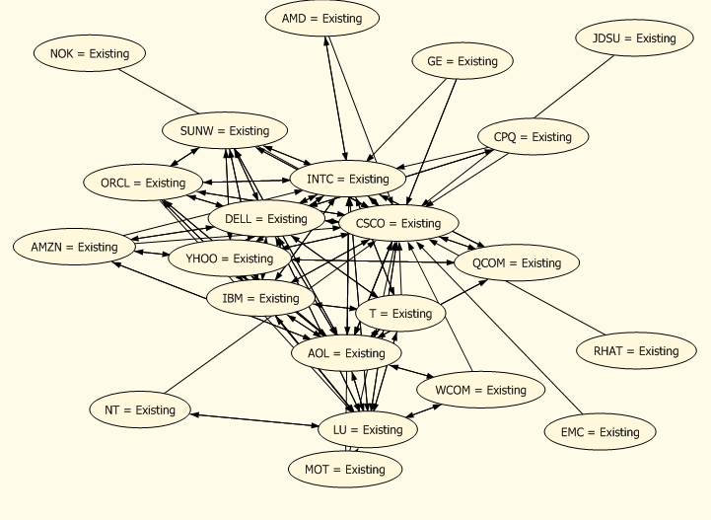
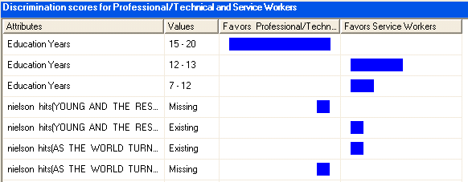
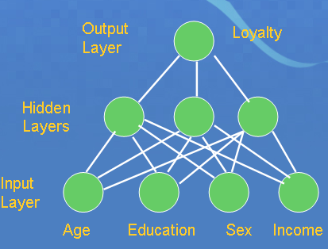
Decision Trees
Clustering
Time Series
Introduced in SQL Server 2000
Sequence Clustering
Naïve Bayes
Association Rules
Neural
Networks

Slide 8
Data Mining Process
Flatten Dataset
Create Model
Update Semi-Regularly
Train Model
Test Model

Slide 9

Excel Data Mining Architecture
BISM Multidimensional
Results
Results
Temporary Model
Permanent Model

Slide 10
Demo
Excel Data Mining

Slide 11
Thank You
Please fill out speaker evaluation
Email: adam@pragmaticworks.com
Twitter: @ajbigdata
Email: dknight@pragmaticworks.com
Twitter: @knight_devin

