Slide 1
Adapting your etl solution to use SSIS 2012
Presentation by Devin Knight (@knight_devin)
dknight@pragmaticworks.com
Notes:
With all the great new features added to SSIS in SQL Server 2012 it is important to understand how they can make your development life easier. This session will not only highlight what is new in SSIS but also show how your existing solutions can be adapted to utilize the latest features. Topics will include changes to usability, deployment, configuration and management.

Slide 2

About Me
BI Consultant and Trainer
Author of 3 SQL Server books
Speaker at events like PASS, SQL Saturdays, and Code Camps

Slide 3
Assumptions
You have developed in SSIS 2005 or 2008
You understand how to deploy packages
You understand concepts of SSIS configurations
You understand concept of Parent/Child packages

Slide 4

Agenda
Upgrading SSIS Packages
Deploying Using Project Deployment Model
Using the SSIS Catalog

Slide 5
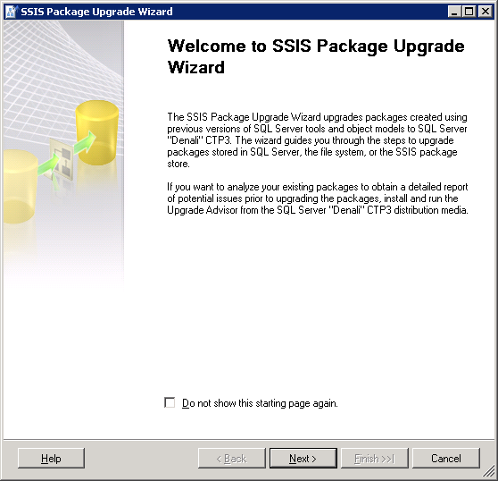
SSIS Package Upgrade Wizard
Launches when you open pre-SQL Server 2012 package in SSDT
Can be run manually with SSISUpgrade.exe
Does not upgrade Package Configurations or Execute Package Tasks
Verify Driver Update
Notes:
C:\Program Files\Microsoft SQL Server\110\DTS\Binn\SSISUpgrade.exe

Slide 6
Demo
SSIS Package Upgrade Wizard

Slide 7
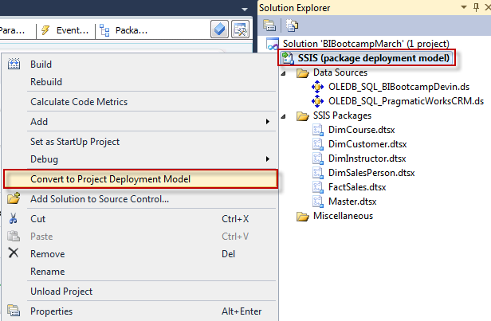
Package Deployment Model
Legacy deployment model
Default deployment for upgraded packages
Unit of deployment is a package
Use Project Conversion Wizard to upgrade to change to Project Deployment Model

Slide 8
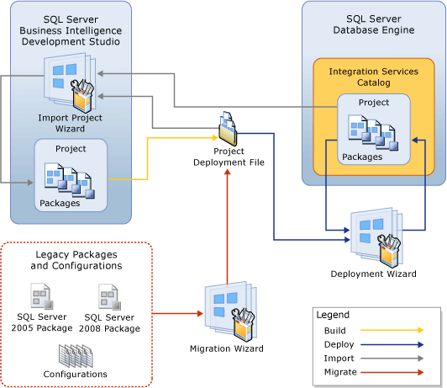
Project Deployment Model
Much simpler to manage and configure
Entire project is deployed to SQL Server at once vs one package at a time
Package configurations are no longer used, replaced with project or package parameters
Easier to reference Child packages from a Parent/Child package design
Can use T-SQL to run packages

Slide 9
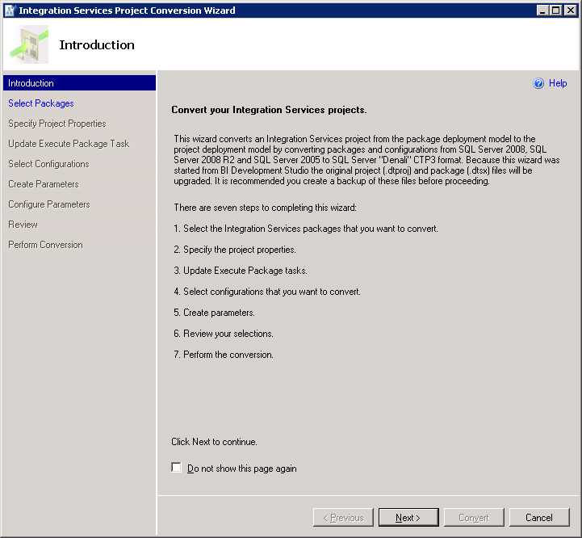
Project Conversion Wizard
Replaces project Data Sources with Shared Connection Managers
Updates Execute Package Task References
Replaces Configurations with Parameters
Update Drivers that are used for Parameters. SQLNCLI10.1 changes to SQLNCLI11

Slide 10
Demo
Project Conversion Wizard and Execute Package Changes

Slide 11
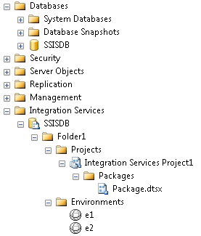
Integration Services Catalog
All SSIS objects are stored and managed in a SQL Server database referred as the Integration Services catalog
Each instance of SQL Server can have one catalog
HA plans or clustering on SQL Server you just get it with SSIS
Project versioning
Deployment done using .ispac file

Slide 12
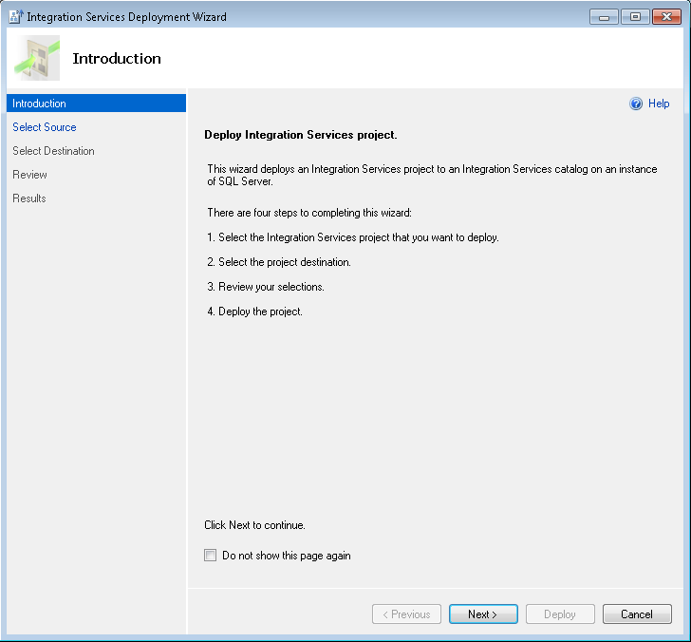
Project Deployment
.ispac file found in the /bin folder of the project
Must deploy to a Folder on the Integration Services Catalog. If one doesn’t exist create one
A folder in the catalog can also be used as a boundary for permissions to Integration Services objects
Management can all be done from SQL Server after deployment

Slide 13
Demo
Create a Integration Services Catalog and Deploying a Project

Slide 14
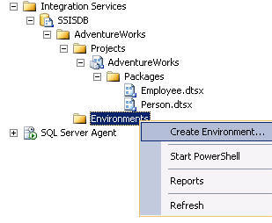
Environments and Environment Variables
Environments
Each project can have multiple Environments
An Environment can hold multiple variables to a project
Environment Variables
Defines a literal value that can be assigned to a parameter during package execution
To use an Environment Variable create an Environment Reference to either project or package

Slide 15
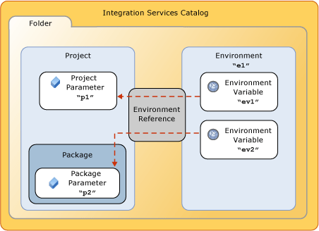
Environment References
Completes the steps of replacing old configurations
After deploying your project you can add multiple environment references to the project or packages inside a project
An environment reference acts as a bridge between an environment and a project.

Slide 16
Demo
Setting up and using Environments
Notes:
1. Create Environments
2. Create Environment Reference on project or package(Configure/References). Parameters set values to use Environments
3. Run Package and assign Environment to that execution
Source - Data Source=Localhost;Initial Catalog=PragmaticWorksCRM;Provider=SQLNCLI10.1;Integrated Security=SSPI;
Destination - Data Source=Localhost;Initial Catalog=BIBootcampMarch_Devin;Provider=SQLNCLI10.1;Integrated Security=SSPI;

Slide 17
Thank You
Please fill out speaker evaluation
Email: dknight@pragmaticworks.com
Twitter: @knight_devin

